Slide 1
Intro to Social Network Analysis
Princeton Data Science
Felix Xiao

Slide 2
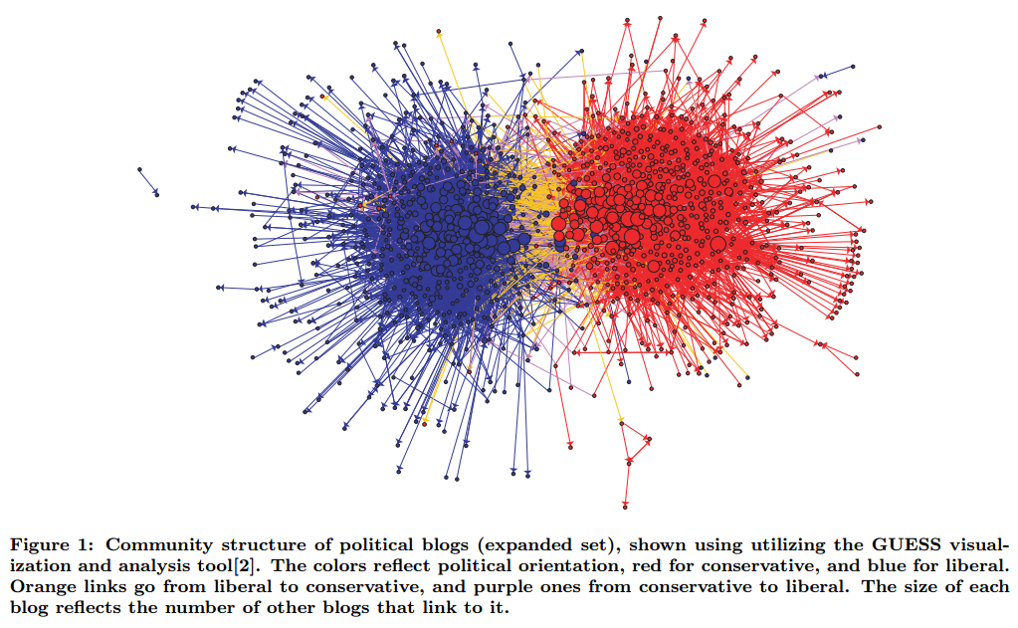
Adamic & Glance (2005)

Slide 3
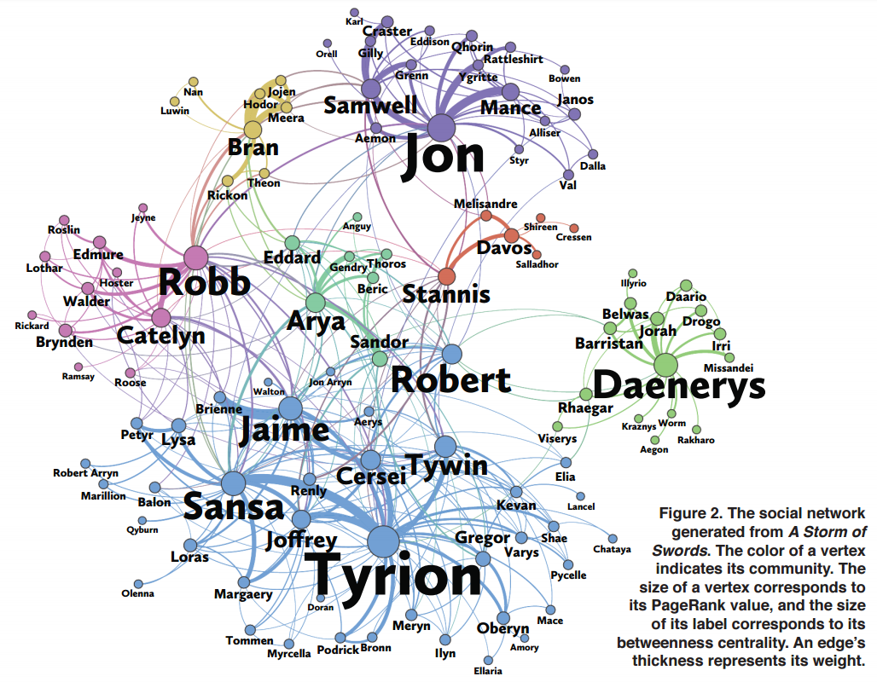
Beveridge & Shan (2016)
https://www.macalester.edu/~abeverid/thrones.html

Slide 4
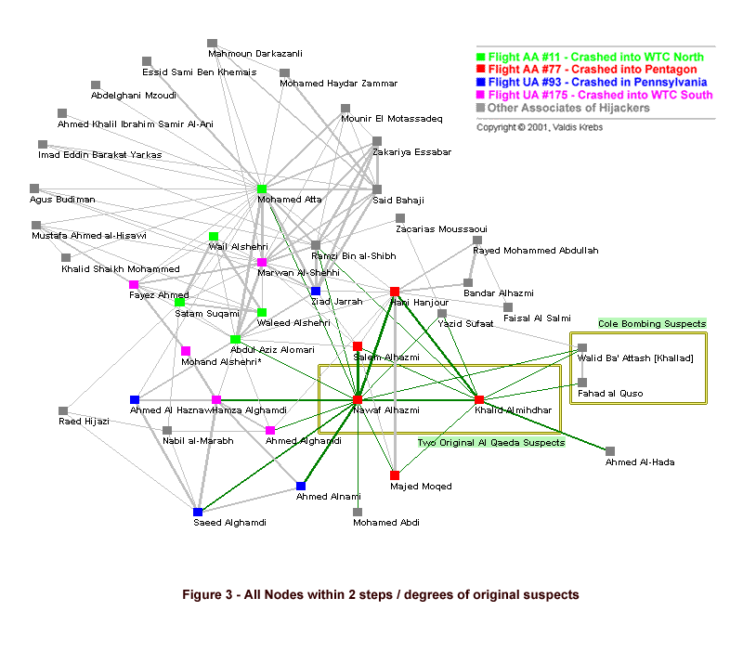

Slide 5
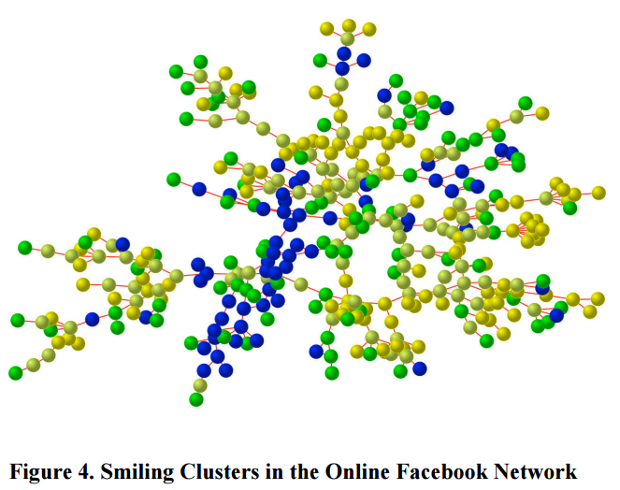
Christakis (2009)

Slide 6
Centrality
Which members are the most important as sources of influence and transmitters of information?
Community
Which members have a higher than average degree of interaction with one another?

Slide 7
Graphs

Slide 8





Measures of Centrality
Degree centrality
Eigenvector centrality

Slide 9

Measures of Centrality
Eigenvector centrality
Theorem: If A is symmetric and has a unique largest-in-absolute-value eigenvalue λ₁ then the sequence {c^{(t)}} converges to c satisfying
Google Search (PageRank) uses a modified form of eigenvector centrality for directed graphs

Slide 10


Measures of Centrality
Harmonic centrality
Let denote the length of the shortest (weighted) path, the geodesic, between vertices i and j.
Intuition: if d_{ij} is large for many other vertices j, then vertex i is likely on the periphery of a graph

Slide 11

Measures of Centrality
Between-ness centrality

Slide 12
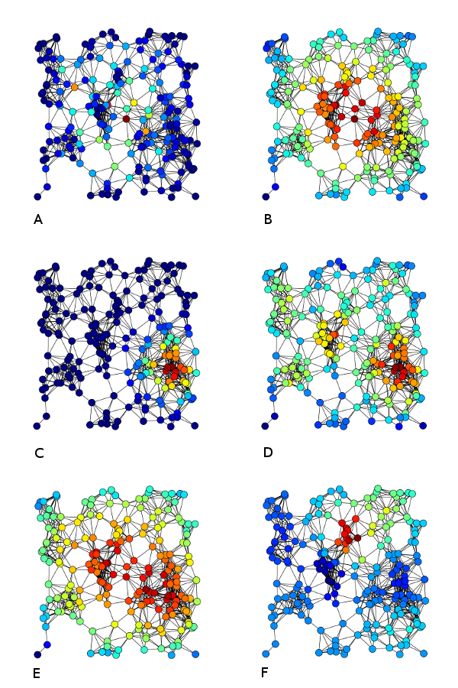
Measures of Centrality
Betweenness
Harmonic
Eigenvector
Degree

Slide 13
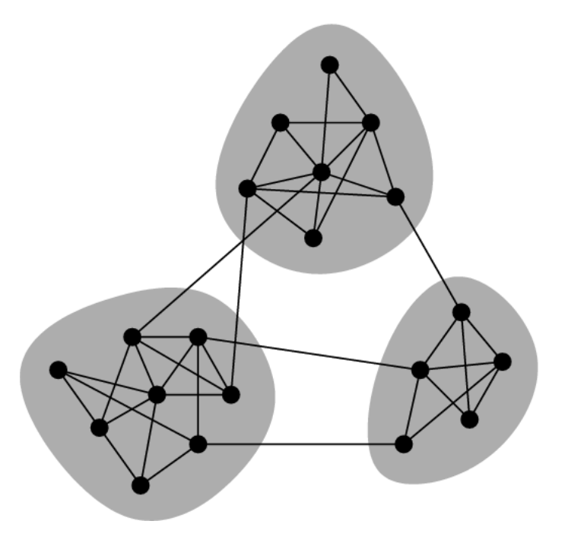
Community Detection
Graph Partitioning
Given a graph with vertices V
Find a collection of k subsets
of V: {V₁, V₂, …, V_{k}} that
are non-empty
do not overlap
add up to V

Slide 14


Community Detection
Minimum Cut Partitioning
Find a k-partitioning
of a graph that minimizes
where A_{V,W} is the submatrix of the
adjacency matrix A.

Slide 15
Community Detection
Bi-partitioning case
useless without any size constraints on the partitions

Slide 16
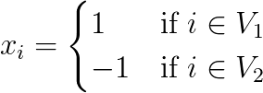
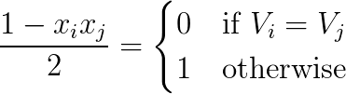

Community Detection
Spectral Partitioning
Let
then
want to find x that minimizes

Slide 17
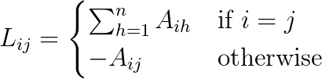

Community Detection
Spectral Partitioning
Define the Laplacian of a graph to be a n-by-n matrix with entries
The spectral relaxation for bi-partitioning is
minimize
subject to

Slide 18
Community Detection
Modularity
Motivation: We want a score function that takes in an adjacency matrix A and a partitioning P and returns a scalar denoting the quality of a partitioning.
Cut size is a poor score function
not enough to have few edges between communities
should have fewer than expected

Slide 19



Community Detection
Modularity
where P_{ij} is the expected weight of edge (i,j) under a null model and
Examples:
P_{ij} = p (Erdos-Renyi random graph)
P_{ij} = k_{i}k_{j} / 2m (configuration model)
where

Slide 20
Community Detection
Modularity
Many methods to approximately maximize Q
spectral method
linear and quadratic programming
greedy agglomeration
simulated annealing

Slide 21
Community Detection
Louvain method for approximately maximizing modularity
assign each node to its own community
stage 1: repeat
for node i in V
for node j in {neighbors of i}
compute ΔQ from merging i into j’s community
merge i to j giving highest positive ΔQ
until no ΔQ > 0 opportunity is available
if no merges occurred after one pass-through of V, stop
stage 2: create a new network:
node = communities
self-edges = sum of within-community edges
between-edges = sum of between-community edges
10. go to stage 1 with new coarse network

Slide 22
Probabilistic Generative Models
Stochastic Block Model
SBM is a distribution of graphs defined by the parameters
- k : number of communities
- z : n-dimensional vector where z_{i} ∈ {1, …, k} denotes the community to which node i belongs
- M: k-by-k with entries M_{uv} giving the probability that a node in community v connects to a node in community u

Slide 23
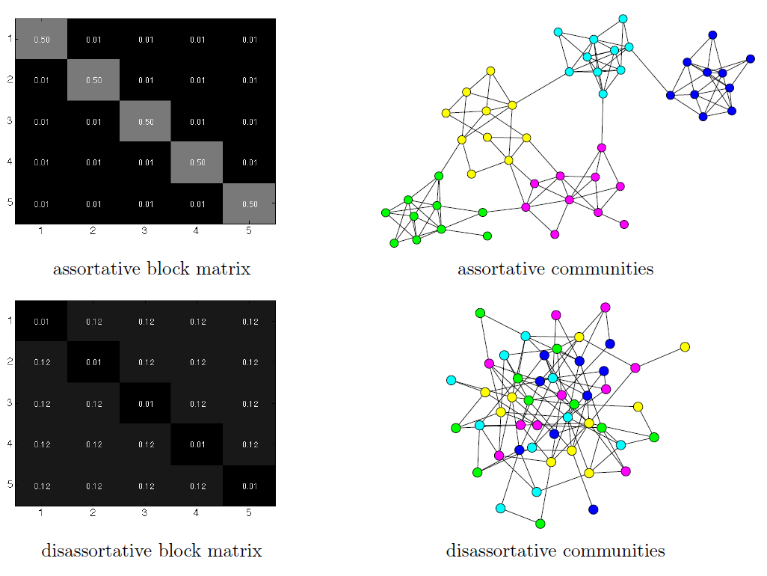
Stochastic Block Model

Slide 24
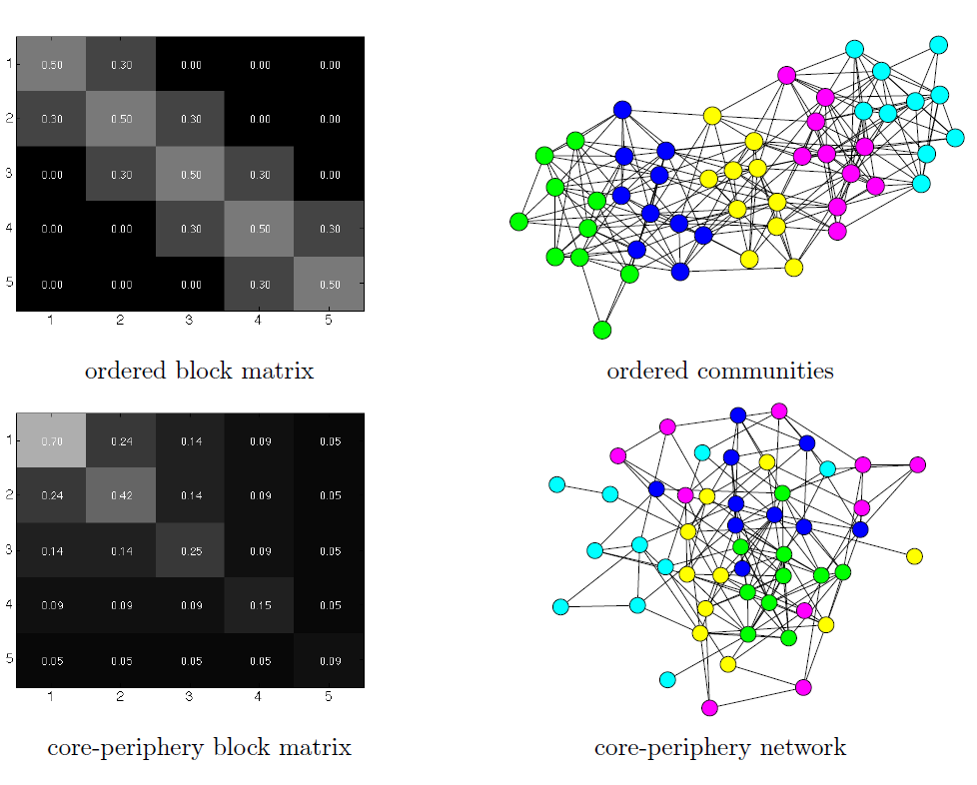
Stochastic Block Model

Slide 25
Stochastic Block Model
Inference
If z and k are known, easy to get M
use Maximum Likelihood Inference
Much harder to get z
EM algorithm, Bayesian methods, …

Slide 26
Data Modeling Challenge
If you have git installed, open terminal in a new empty folder and type in
Otherwise, go to https://github.com/felixxiao/data-night1 and “Download Zip”
git init
git remote add origin https://github.com/felixxiao/data-night1
git pull origin master

Slide 27
References
Blondel, Vincent D., et al. "Fast unfolding of communities in large networks."Journal of statistical mechanics: theory and experiment (2008)
Course: Network Analysis and Modeling http://tuvalu.santafe.edu/~aaronc/courses/5352/
Presentation: “Modularity, Community Structure, and Spectral Properties of Networks” http://vw.indiana.edu/netsci06/conf-slides/conf-mon/netsci-talk-mark-newman.pdf

